Slide 1


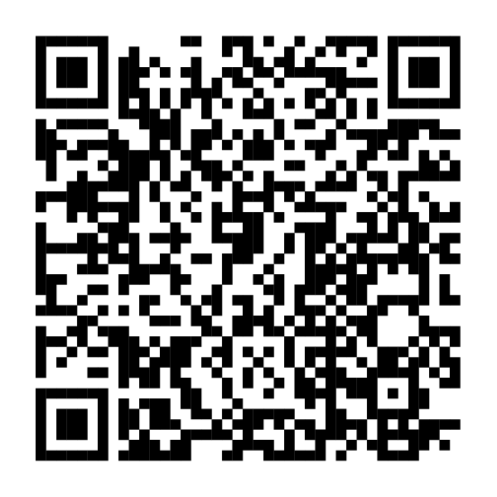
You’ve got free HSA money
waiting for you.
If you enrolled in the [HSA-eligible health plan NAME], don’t forget to open your Fidelity HSA® to get your employer’s contribution (free money).
Scan this code or visit NetBenefits.com
to quickly open your Fidelity HSA.
Fidelity Brokerage Services LLC, Member NYSE, SIPC, 900 Salem Street, Smithfield, RI 02917
© 2024 FMR LLC. All rights reserved.
1127254.1.0
CLIENT LOGO

